Slide 1
Real-time Distracted Driver Detection using Deep Learning
Ming Tang
COURSE CODE :- ECE_5831
Pattern Recognition and Neural Network
Notes:
Title Slide Option #4

Slide 2
Background information
Function: This project aims to develop a real-time system that analyzes visual cues from in-vehicle cameras to accurately predict various driver distraction states, including texting, talking on the phone, or looking away.
Benefit: The system's primary benefit is to enhance road safety by providing timely alerts for driver inattention, thereby minimizing accidents, reducing fatalities, and improving overall driving behavior.
Dataset: AUC Distracted Driver Dataset (V2)
This dataset comprises images from multiple camera angles (Camera 1 and Camera 2), categorized into ten distinct driver states (c0-c9), including safe driving and various forms of distraction. It is specifically designed for research in driver distraction identification and allows for evaluation based on driver splits.
c0: Safe Driving
c1: Text Right
c2: Talk Right
c3: Text Left
c4: Talk Left
c5: Adjust the Radio
c6: Drink
c7: Reaching Behind
c8: Hair and Makeup
c9: Talk to Passengers
Notes:
Standard template for UM-Dearborn info. Adjust as needed based on your audience.

Slide 3
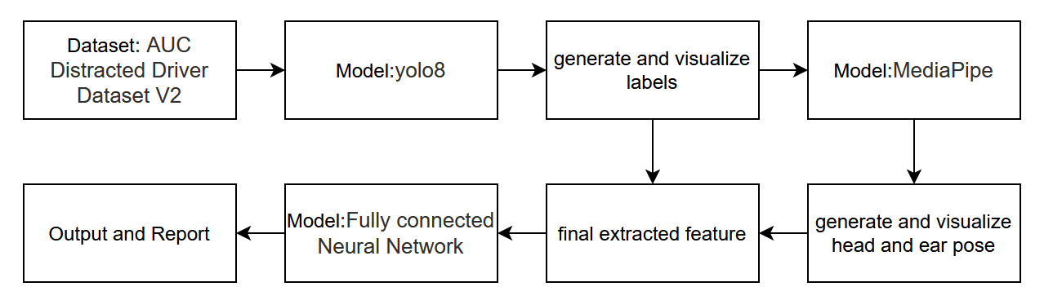
Flowchart

Slide 4
Overview of YOLO's Role
YOLOv8 serves as the initial computer vision module in our pipeline, primarily responsible for object detection. Its task is to identify key elements in the dataset images: the driver (person), and any distracting objects like cell phones or bottles. The output of YOLOv8 forms the foundation of our pseudo-labels, which are crucial for subsequent feature extraction.

Slide 5
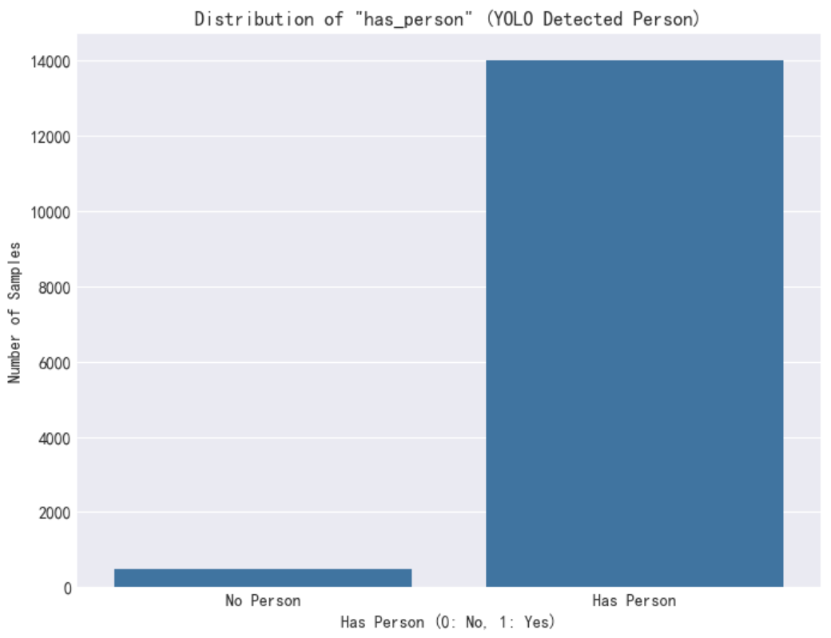
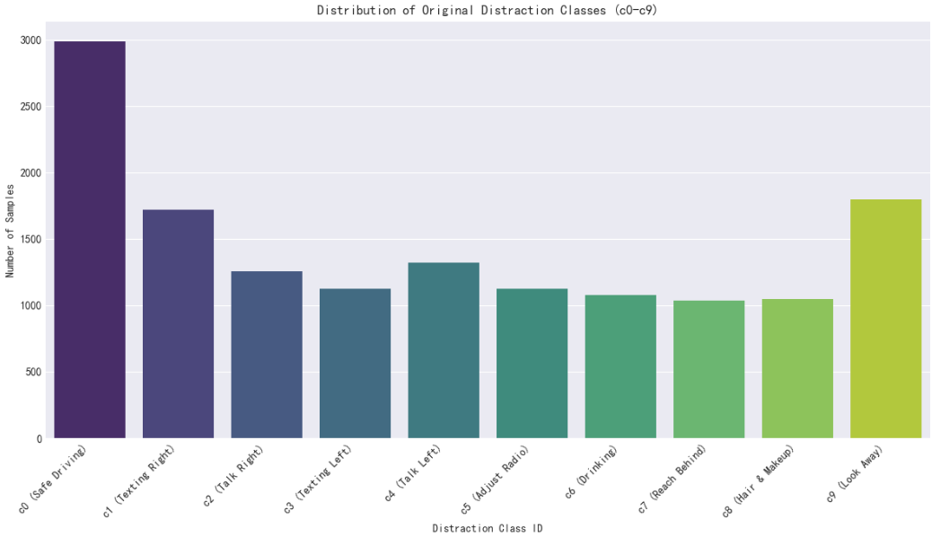
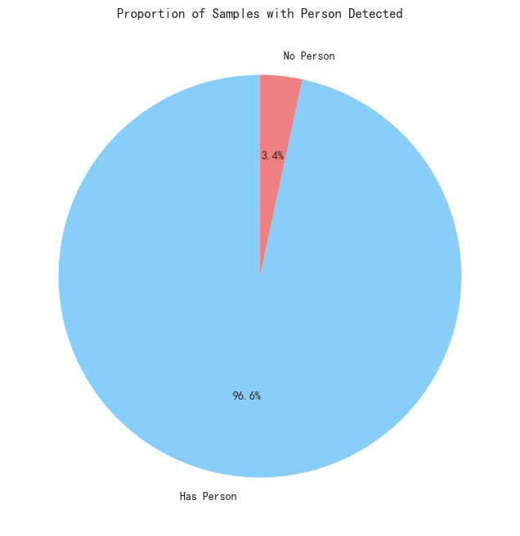
Yolo V8 Output Visualization
Probability of detecting a person
Data distribution
Notes:
Standard template for UM-Dearborn info. Adjust as needed based on your audience.

Slide 6
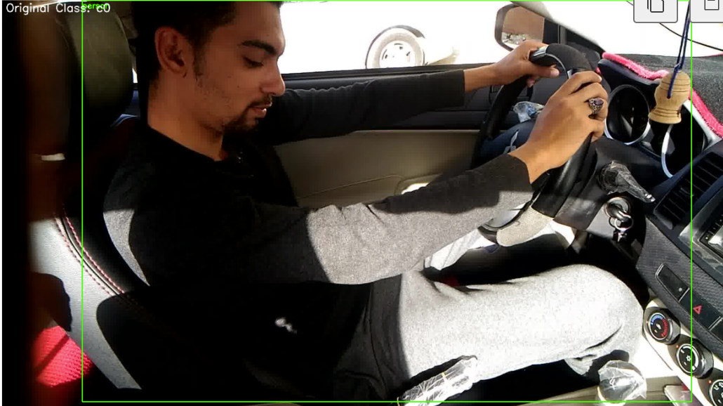
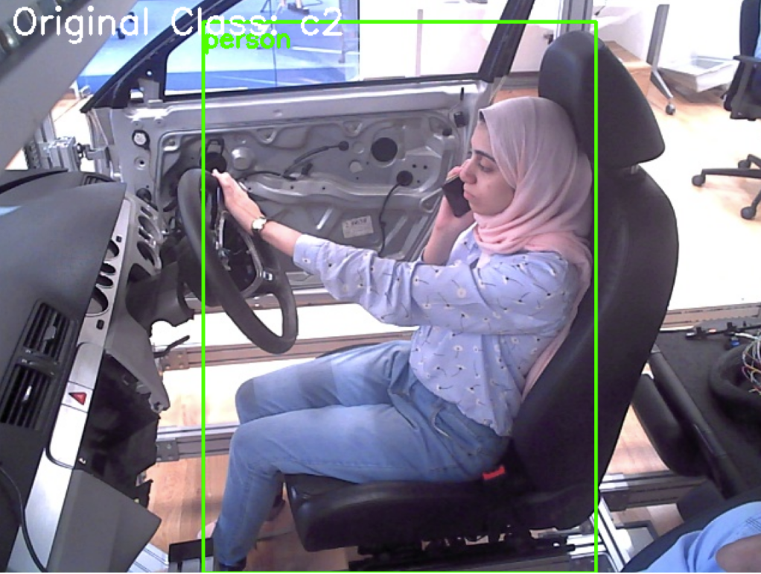
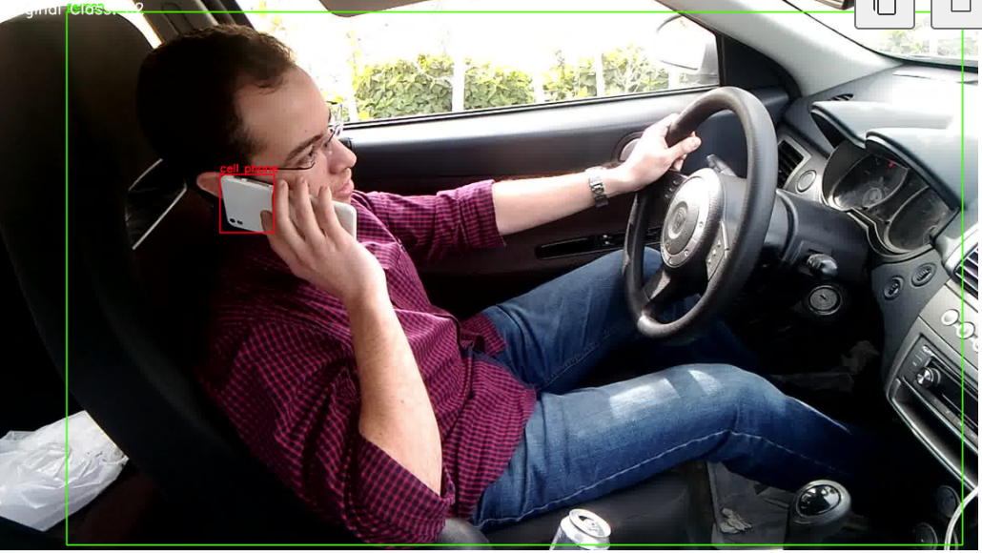
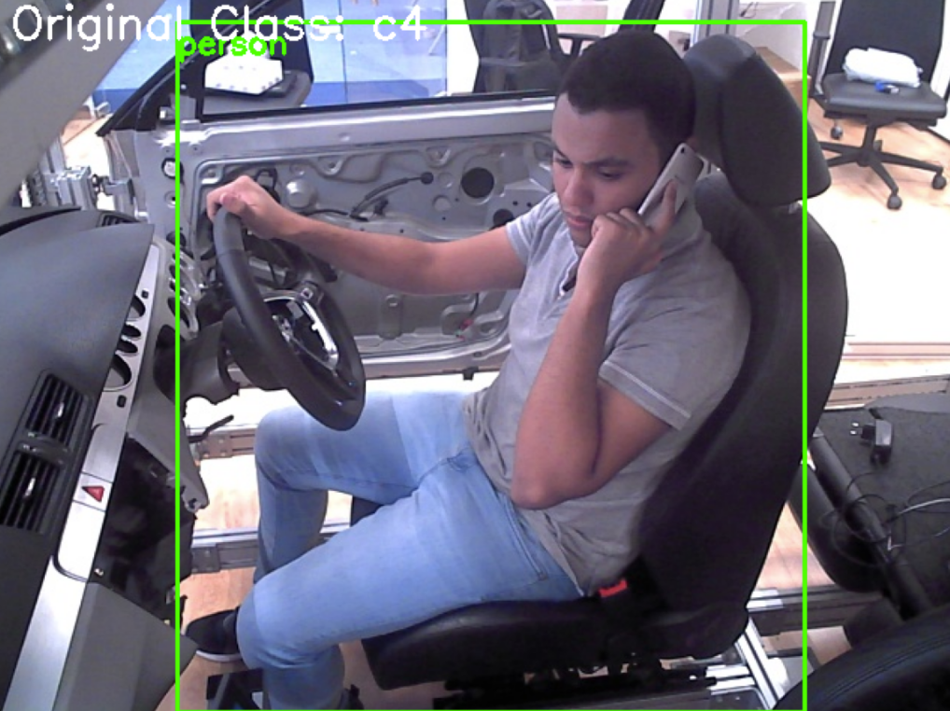
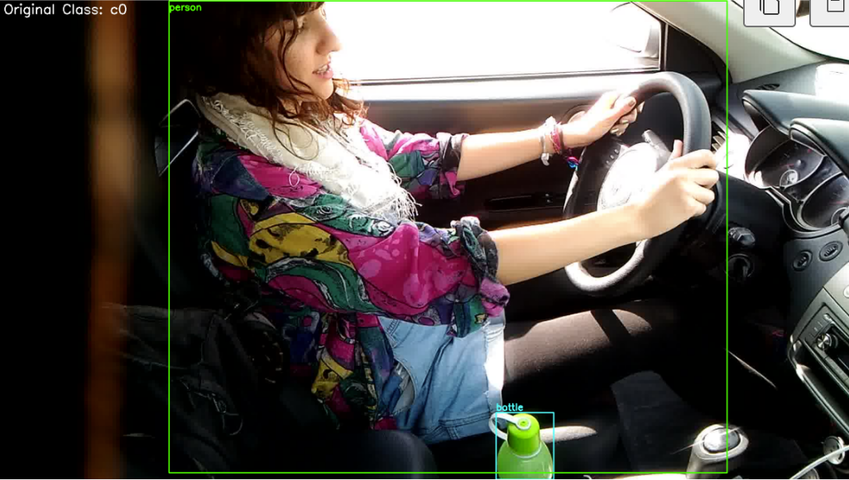
Yolo V8 Output Visualization
Person
Person cellphone
Person cellphone
Person cellphone
Person bottle
Notes:
Standard template for UM-Dearborn info. Adjust as needed based on your audience.

Slide 7
Yolo V8 summary
Strength: YOLOv8 reliably detects the driver ('person') and primary distracting objects ('cellphone', 'bottle') with high accuracy, forming robust pseudo-labels for our system.
Foundation for Feature Extraction: The precise bounding box for 'person' is vital, as it allows MediaPipe to focus its facial analysis on the correct region, enhancing the accuracy of EAR and head pose estimation
Notes:
While YOLO provides excellent object localization, simple object presence doesn't always directly equate to a distraction state. The combination with MediaPipe features is essential for discerning the true distraction behavior.

Slide 8
Use Mediapipe to extract feature from ‘person’
Following YOLOv8's object detection, our system utilizes Google's MediaPipe Face Mesh, a robust and efficient framework for high-fidelity 3D facial landmark detection. MediaPipe's role is critical for extracting more subtle and detailed visual cues about the driver's state. Specifically, it allows us to precisely calculate the Eye Aspect Ratio (EAR) to monitor for signs of drowsiness or inattention, and to estimate the Head Pose (Pitch, Yaw, Roll angles) to determine the driver's head orientation. These fine-grained facial features provide essential information for classifying various non-object-based distraction behaviors.

Slide 9
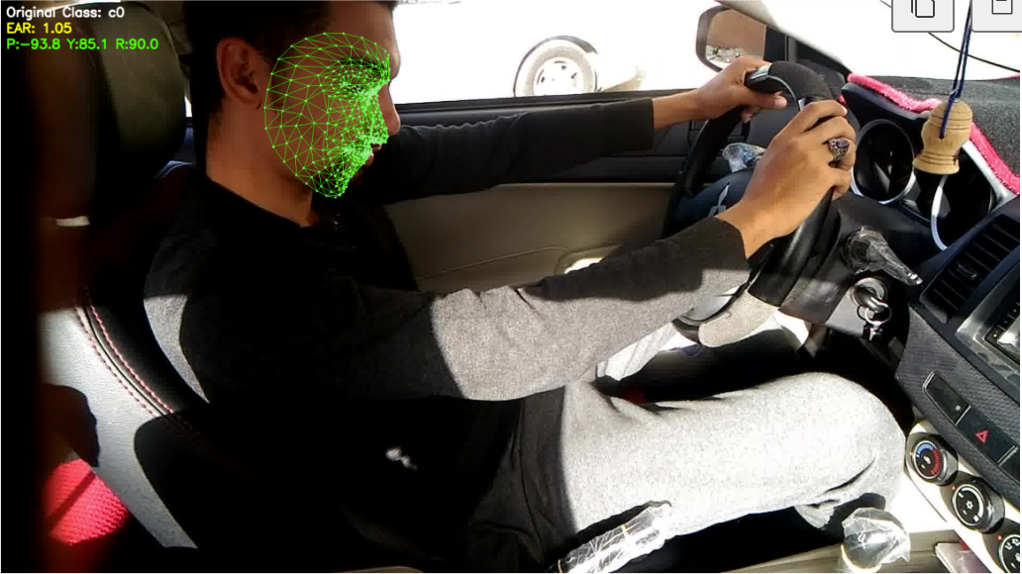
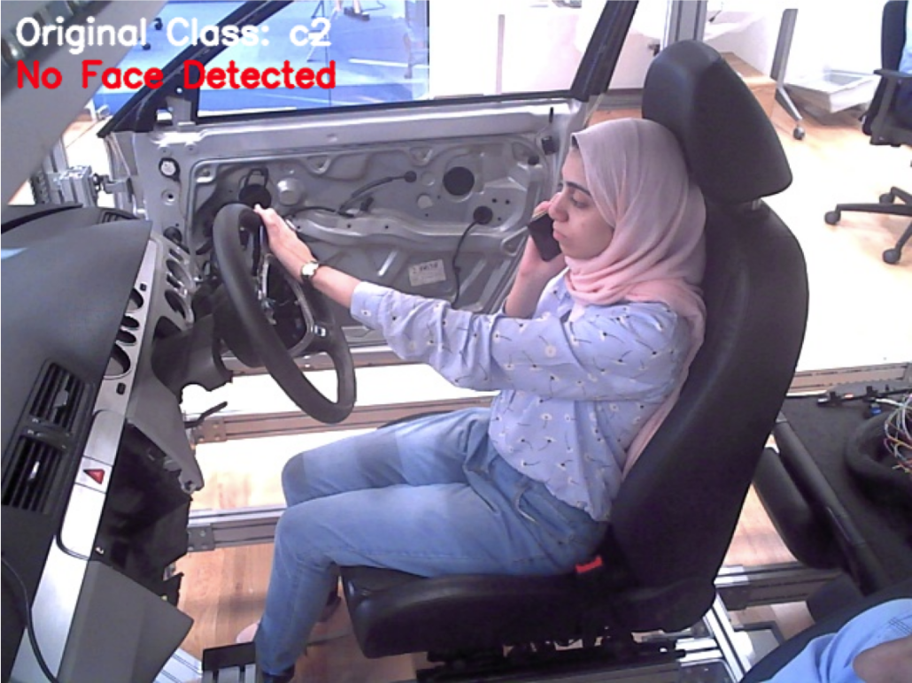
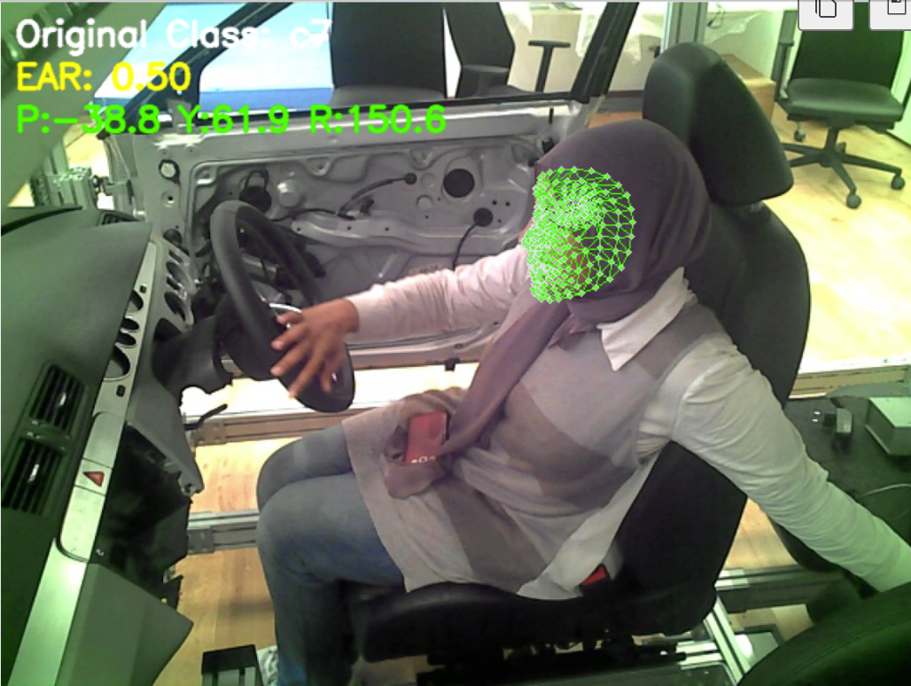
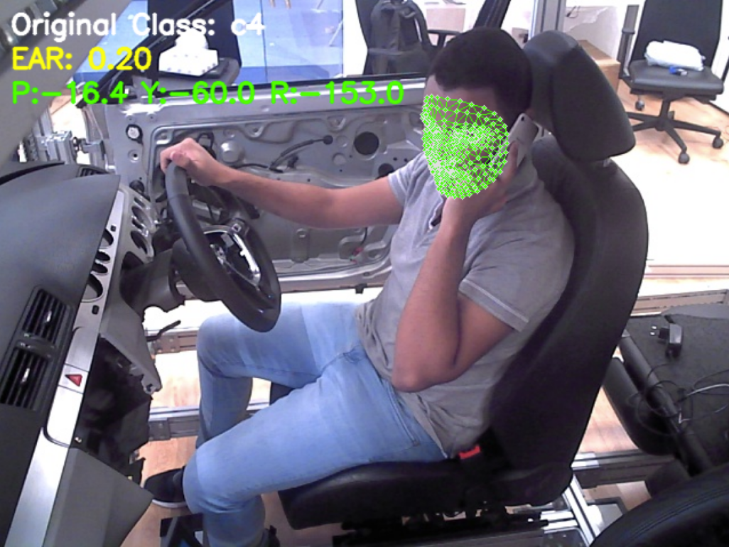
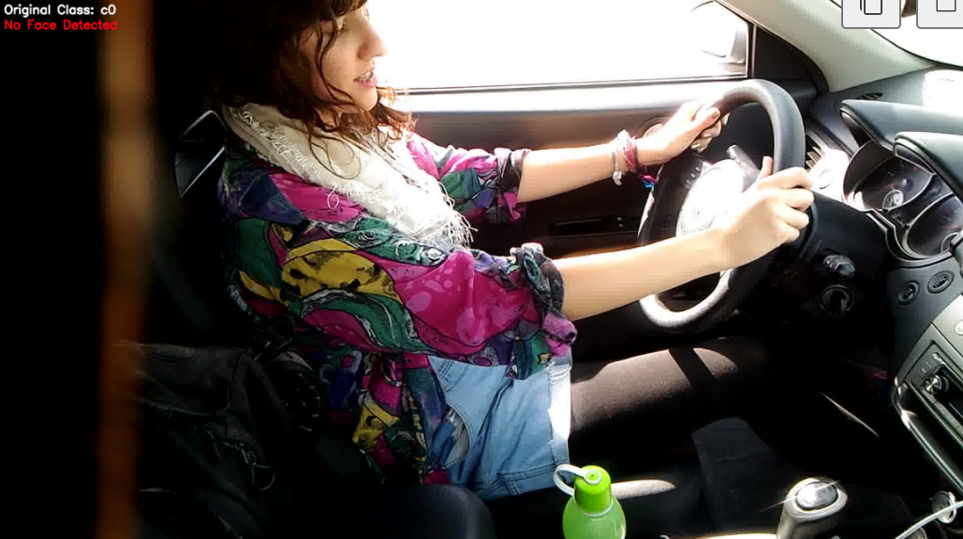
Use Mediapipe to extract feature from ‘person’

Slide 10
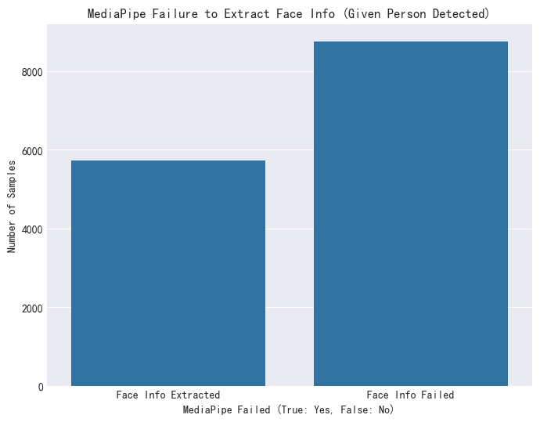
Use Mediapipe to extract feature from ‘person’
40% successfully extract the facial feature

Slide 11
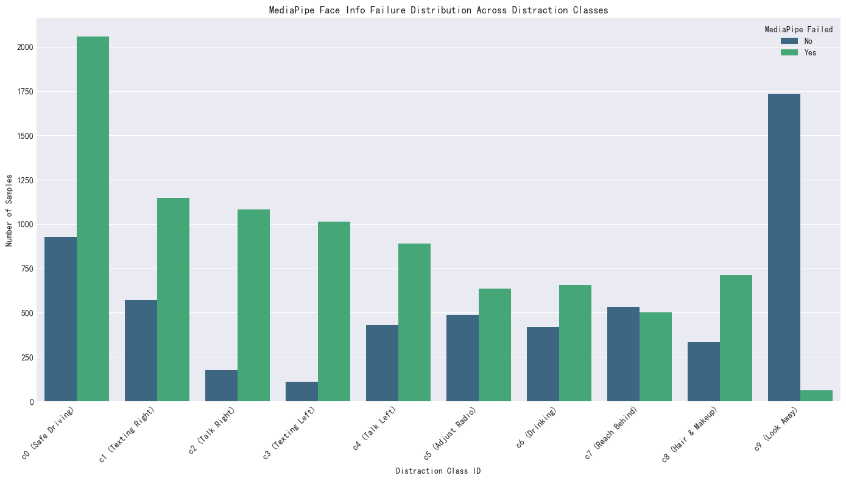
MediaPipe summary

Slide 12
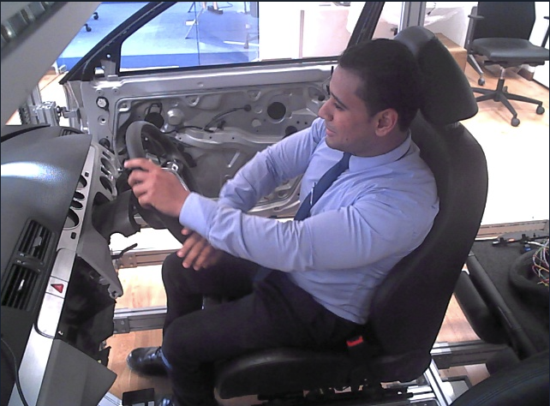
C0 Pic example
c0 (Safe Driving): This class shows a significantly taller green bar, indicating that for most "Safe Driving" samples, MediaPipe failed to extract meaningful face information. This might be due to drivers maintaining a very straight head pose, which offers less distinctive movement for pose estimation, or perhaps subtle variations in image quality or angle for "standard" faces.

Slide 13
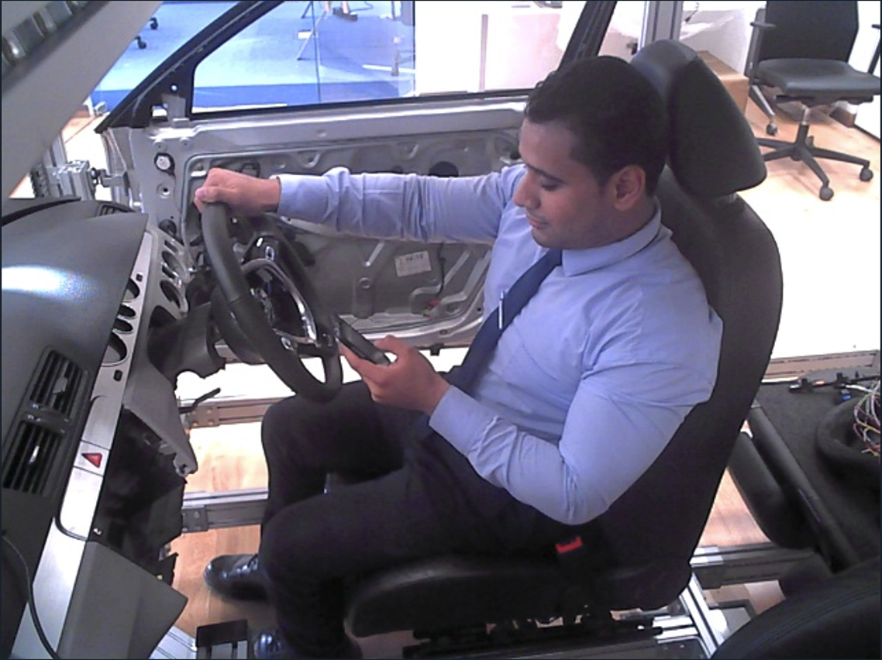
C3 Pic example
c3 (Texting Left): The green bar is much taller than the blue bar, suggesting a high failure rate for MediaPipe in extracting pose/EAR in the "Texting Left" category. This could be attributed to the driver looking down at their phone, leading to an unfavorable face angle or partial occlusion, making face landmark detection challenging.

Slide 14
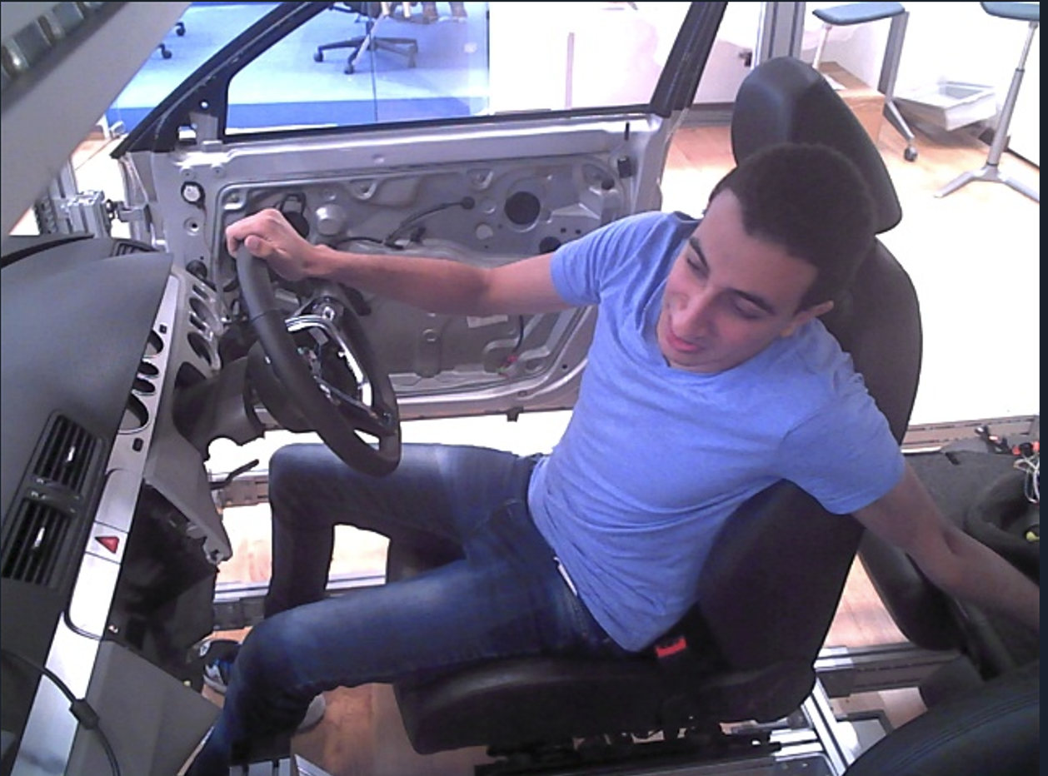
C7 Pic example
c7 (Reach Behind): This class shows a mixed distribution, with the green bar being slightly taller, implying more failures than successes. "Reaching Behind" actions often involve significant head rotation or body contortion, which might push the face into extreme angles that MediaPipe struggles to process accurately.

Slide 15
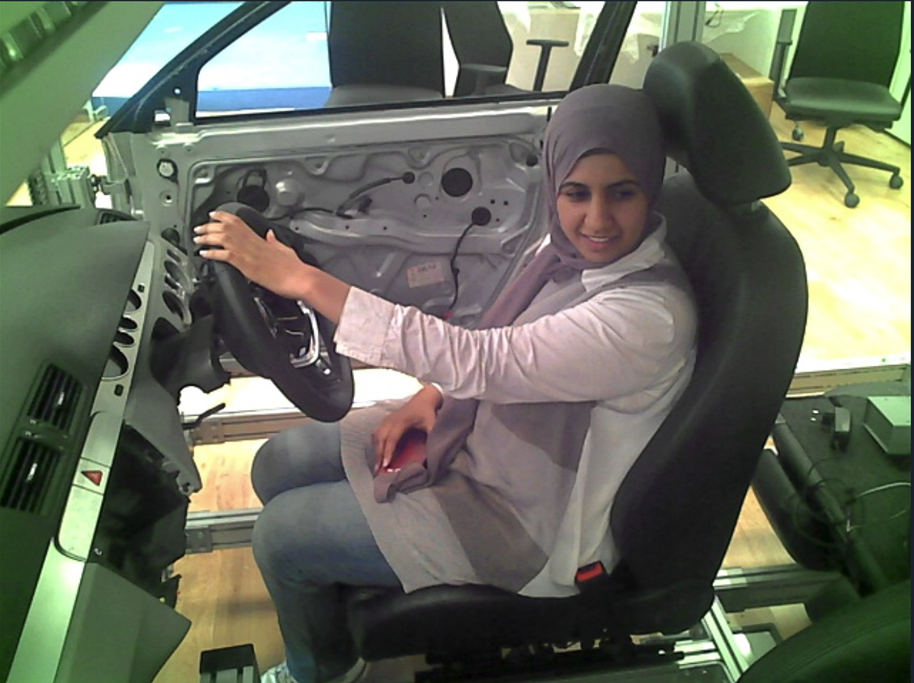
C9 Pic example
c9 (Look Away): This class has a very tall blue bar and a very small green bar. This is a positive sign, as it indicates that for the "Look Away" behavior, MediaPipe largely succeeded in extracting face information (Head Pose/EAR). This is reasonable, as looking away often involves a distinct head turn, providing clear signals for pose estimation.

Slide 16
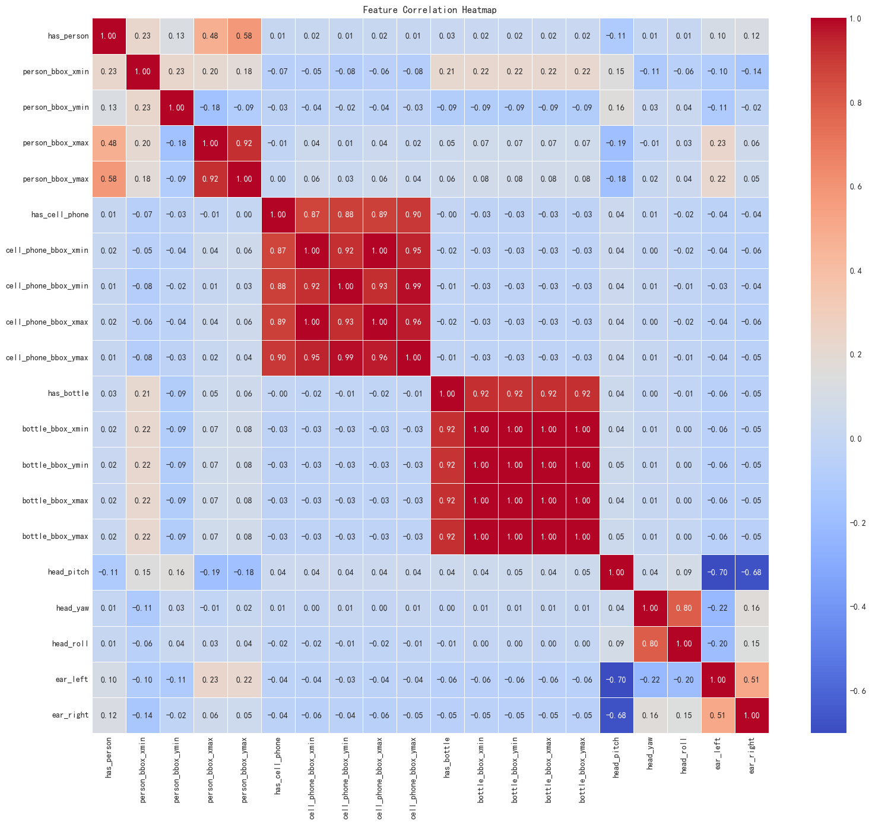
Final feature heatmap
High Intra-Object Correlation (e.g., Cell Phone, Bottle): Features describing the bounding box of a single object (like a cell_phone or bottle's xmin, ymin, xmax, ymax) show very high correlation (approaching 1.00). This is expected as these values are geometrically interdependent, defining the same rectangular area.
Moderate Correlation within Person Bounding Boxes: For the person bounding box, the internal coordinate correlations are strong but not as absolute. This reflects the greater variability in the driver's body pose and scale within the image.
Meaningful Head Pose & EAR Correlations: head_yaw and head_roll show a notable positive correlation (0.80), suggesting that head turns are often accompanied by a slight tilt. ear_left and ear_right also correlate positively (0.51), indicating synchronized eye movements.

Slide 17
Handling Feature Correlation in Neural Networks
"Unlike traditional linear models which can suffer from multicollinearity, neural networks, especially with Dropout regularization, are generally more robust to highly correlated inputs.
Learn Redundancy: Internally learn to effectively down-weight or ignore redundant features.
Extract Richer Patterns: Sometimes, highly correlated features provide complementary information or reinforce a signal, allowing the network to extract richer, non-linear patterns that a simpler model might miss.
Enhanced Robustness: Dropout helps prevent the network from over-relying on any single feature or specific combinations, contributing to better generalization even with correlated inputs.“
"Therefore, including these features offers the network a comprehensive set of visual cues, letting it autonomously discern the most impactful relationships for distraction classification."

Slide 18
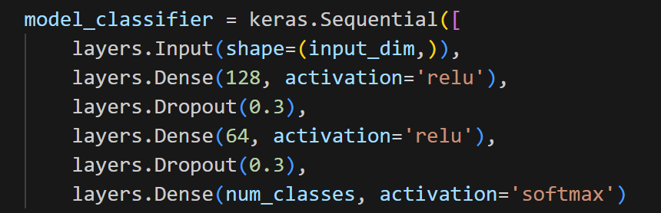
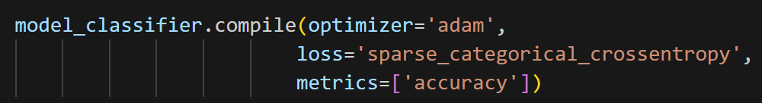
MLP
Notes:
Other distribution map

Slide 19
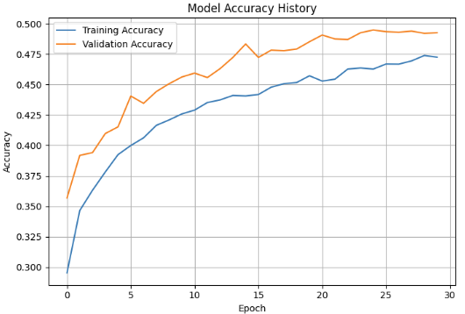
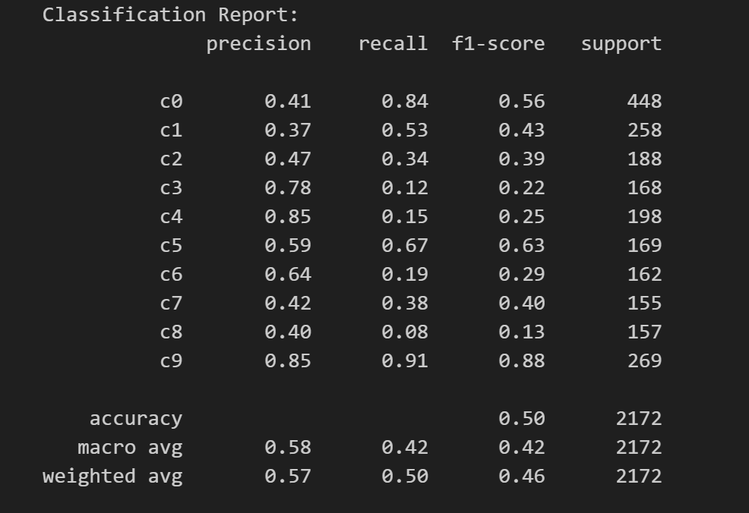
MLP Output

Slide 20
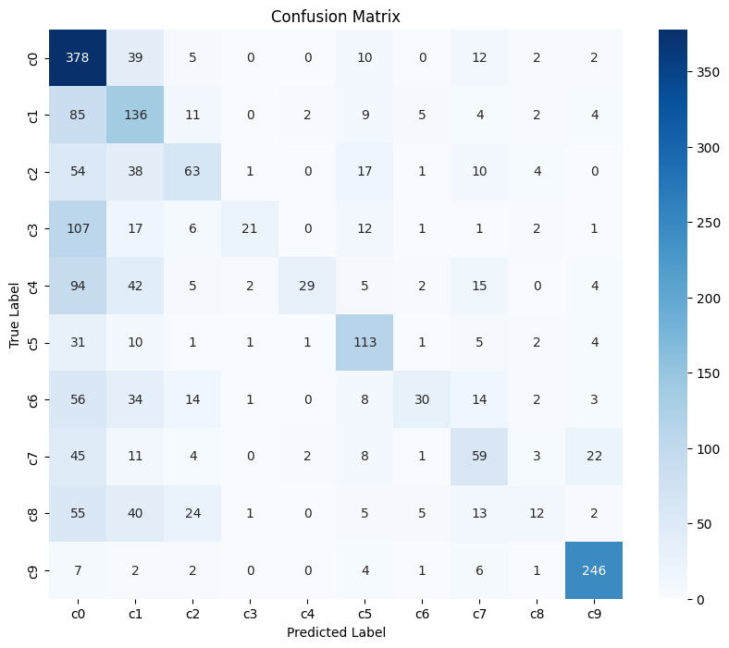
Confusion Matrix
Notes:
"We observe significant confusion for c0 (Safe Driving): A considerable number of samples that were actually c1 (85), c3 (107), c4 (94), c6 (56), c7 (45), and c8 (55) were incorrectly predicted as c0. This indicates the model has a tendency to default to 'Safe Driving' when uncertain about other distraction types, leading to a high false positive rate for c0."
"There's also notable confusion between c1 (Texting Right) and c2 (Talk Right): 38 samples of c2 were predicted as c1, and 39 samples of c1 were predicted as c0. This suggests that the visual cues for these right-hand distractions might be similar or challenging for the model to precisely distinguish."
"Similarly, c5 (Adjust Radio) shows some confusion with c0 (31 actual c5 predicted as c0) and c1 (10 actual c5 predicted as c1), but also quite a few correct predictions (113)."
"Categories like c3 (Texting Left), c4 (Talk Left), and c8 (Hair & Makeup) exhibit relatively low diagonal values and higher off-diagonal values, particularly being misclassified as c0. This explains their lower recall rates in the classification report."

Slide 21
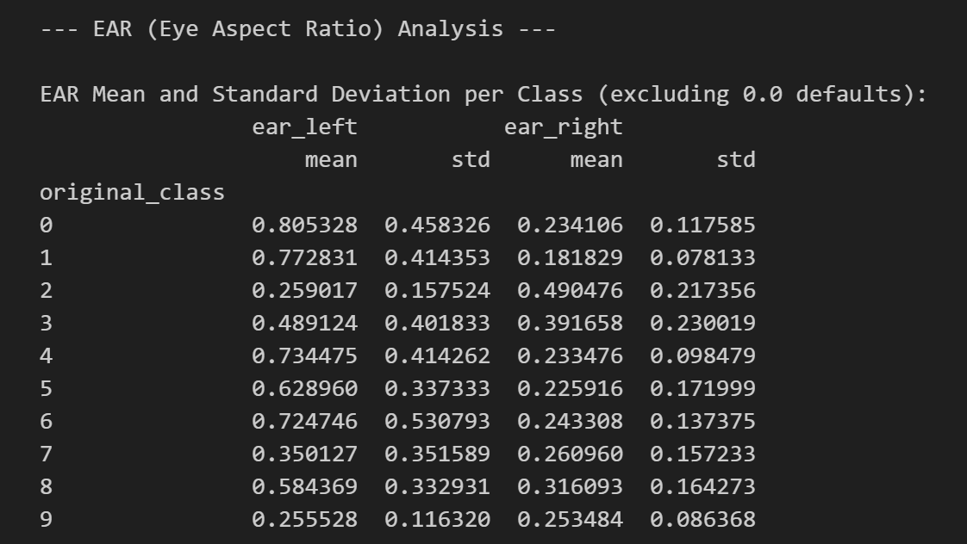
Eye Aspect Ratio (EAR) Analysis
Notes:
Key Finding - Asymmetry: "First, we noticed something interesting: the left and right eye EARs often look quite different in many of our distraction categories, like 'Safe Driving' or 'Texting Right.' For example, the left eye's EAR is often much higher. We think this could be because of where the camera is placed, or maybe how the driver's head is turned, or even just how MediaPipe sees each eye differently when the head moves."
Discriminative Patterns: "But even with that left-right difference, the box plots actually show some clear patterns for specific distractions. For instance, when a driver is 'Talking Right' (c2) or 'Looking Away' (c9), their left eye's EAR tends to be much lower compared to when they're driving safely (c0). What's cool is, for 'Talking Right' (c2), the right eye's EAR actually looks a bit higher than the left. This could mean drivers might be sort of squinting or closing one eye a bit during certain movements, or their head turns just make it harder for the system to 'see' one eye as well."
Value Proposition: "So, even though these differences are subtle, they're definitely there in the data. This tells us that EAR, even if drivers aren't falling asleep, can still give our model useful, unique clues to help it tell the difference between various ways a driver might be distracted. Our classifier can actually learn to pick up on these specific eye patterns!"

Slide 22
Conclusion
In this project, we successfully developed and implemented a comprehensive deep learning pipeline for multi-class driver distraction detection. Our key achievements include:
Robust Feature Extraction: We built a multi-stage feature extraction system that effectively combines:
YOLOv8: For accurate object detection (person, cellphone, bottle/cup) and generating pseudo-labels.
MediaPipe Face Mesh: For precise facial landmark detection, enabling the calculation of Eye Aspect Ratio (EAR) and 3D Head Pose (Pitch, Yaw, Roll angles).
Feature Analysis & Insights: We performed detailed analysis of the extracted features, including correlation heatmaps and distribution plots. This revealed meaningful relationships between features and highlighted the nuanced behavior of EAR and head pose across different distraction categories.
Functional Classifier: We successfully trained a MLP classifier using these combined features, capable of categorizing driver states into 10 distinct distraction classes (c0-c9).
Model Performance & Context: The final classifier achieved a test accuracy of approximately 50%. While this signifies a substantial improvement over random chance in a complex 10-class problem, it's crucial to acknowledge the dataset's characteristics. Due to the dataset's nature where drivers are mixed across train/test splits, this accuracy reflects the model's performance on known driver identities in new situations, rather than strict generalization to entirely unseen drivers.
Notes:
Restate Project Goal and Value
Summarize Key Findings and Achievements
Discuss Limitations and Future Work

Slide 23
Thank you
Notes:
Divider Slide Option #3

